Slide 1
ABM Coursework Rumor Spreading Model
——by Team Halo

Slide 2
Contents
Background
Basic model
Modified model
Calibration and Validation
Sensitivity Analysis
Conclusion
Suggestions
Limitation and future work

Slide 3
Background

Slide 4
Background
Research Purpose
There are a lot of rumors on social media. Their existence does great harm to our society, because many people may hurt themselves or others after brainwashed by them.
According to this situation, our group decide to make a rumor spreading model in order to find some factors that may affect rumor spreading

Slide 5
Background
Scale-free Network
The spread networks are "scale-free". The agent in this kind of network is highly heterogeneous. It means that a few hubs have lots of connections, while everybody else only has a few. Social media network like twitter network belongs to this kind of network.
There is a Preferential Attachment model in the networks section of the NetLogo models library. It generates a network where the probability of a new link being connected to a node is proportional to the number of links the node already has.

Slide 6
Background
SIR Model
The spread of virus has many similarities to the spread of rumors.
Traditional virus spreading is usually based on SIR model: it divides the population into susceptible people(S), infected people(I) and recovered people(R). S means that an individual may be infected by infected people. Once he/she contacts the infected people(I), he/she will become infected. R indicates that after one or more cycles of infection, the individual will never be infected again.

Slide 7
Basic Model

Slide 8
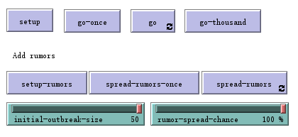
Basic Model
The basic rumor model is based on the traditional virus spreading model. We divide the basic model into two parts.
Network Generation
In this part we set a “scale-free” network. We could use the “setup” button and “go-thousand” button to generate a network of 1000 susceptible agents.
Spread Process
In the second part, we could set the initial number of rumormonger which is agent I and the spread probability of the rumors by using “initial-outbreak-size” slide, “rumor-spread-chance” slide and ‘setup-rumors’ button.

Slide 9
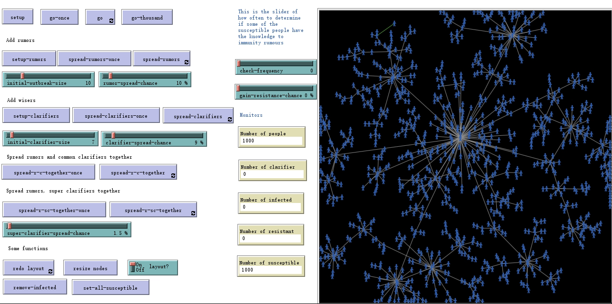
Basic model (S-I)
Here, we generate a network with 1010 nodes so that we can observe the network easily. After this process, we spread rumors with initial size 10 and rumor spread probability 10%. We can see that the speed of the rumor spreading is very fast without any counter measures. The main factor to affect the speed is the rumor spread probability.

Slide 10
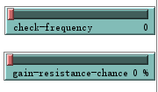
Basic Model (S-I-R)
In virus spreading the recovered agent could be transferred from infected agent, while in rumors spreading model, agent R is resistant agent who transfers from susceptible agent which means the agent learn by his/herself to get the ability of avoiding the rumors.
Therefore, we set two slides: “check frequency” and “gain-resistance-chance”. The first slide stands for a certain time step and the second slide stands for a probability.
This function means that some susceptible people will become resistant after every few seconds during the process of rumor spreading. These resistant people will never be infected.

Slide 11
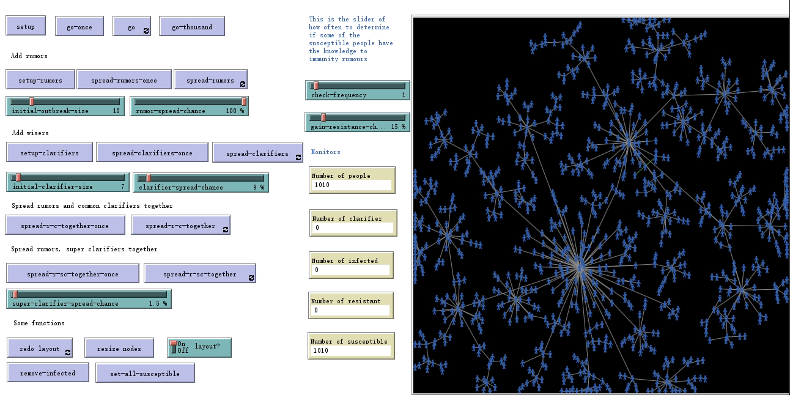
Basic Model (S-I-R)
We can see that resistant people may have a great effect on spread process. Even though we set rumor spread probability to 100% and gain resistant probability to 15%, the infected still can not dominate all nodes.
In order to further study the counter part of rumor spreading, we decide to involve clarifiers and super clarifiers in the experiment.

Slide 12
Modified Model

Slide 13
Modified Model
Based on traditional model, we added two more kinds of agents: clarifiers (C) and super clarifiers (SC).
Clarifiers represent those who can tell and think about things rationally without being affected by other people. They can make infected people become resistant with a certain probability. For instance, expert in a certain field. (S-I-C model)
Super clarifiers can make people who are not super clarifiers become super clarifiers directly with a certain probability. For example, an official institution or organization of a country. (S-I-SC model)

Slide 14
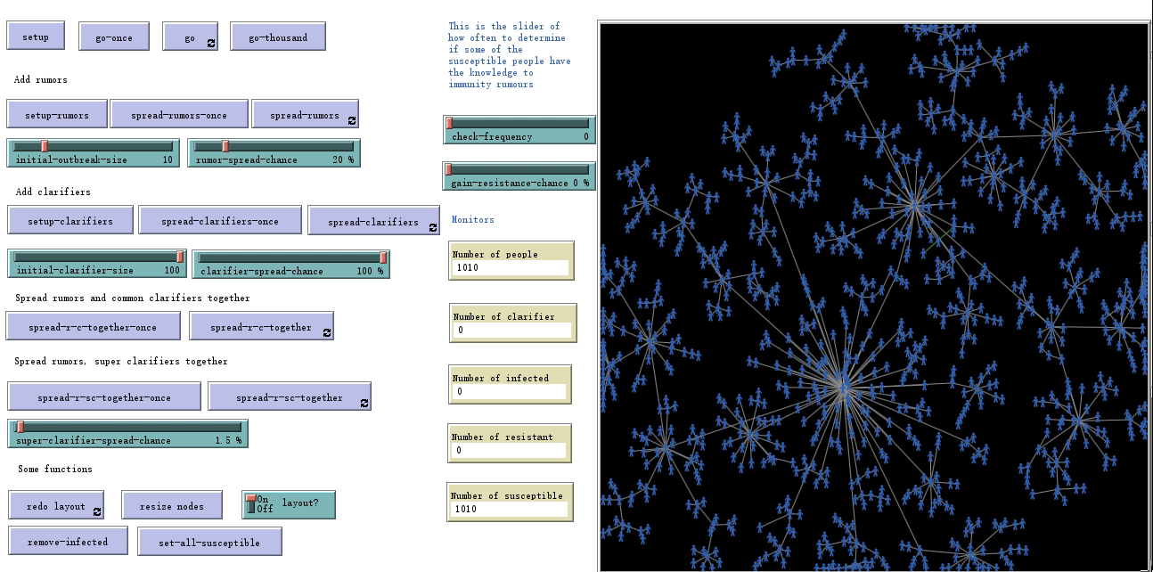
Modified Model (S-I-C)
When we first spread rumors and then spread clarifiers, we can find even though we set the number of clarifiers to the maximum, they can only play a finite role in preventing rumors from spreading because they can only affect people near them. Moreover, there are only few resistant people.
We guess the position of a clarifier in a cluster may also make a big difference, which means the center of a certain cluster may play an important role.

Slide 15
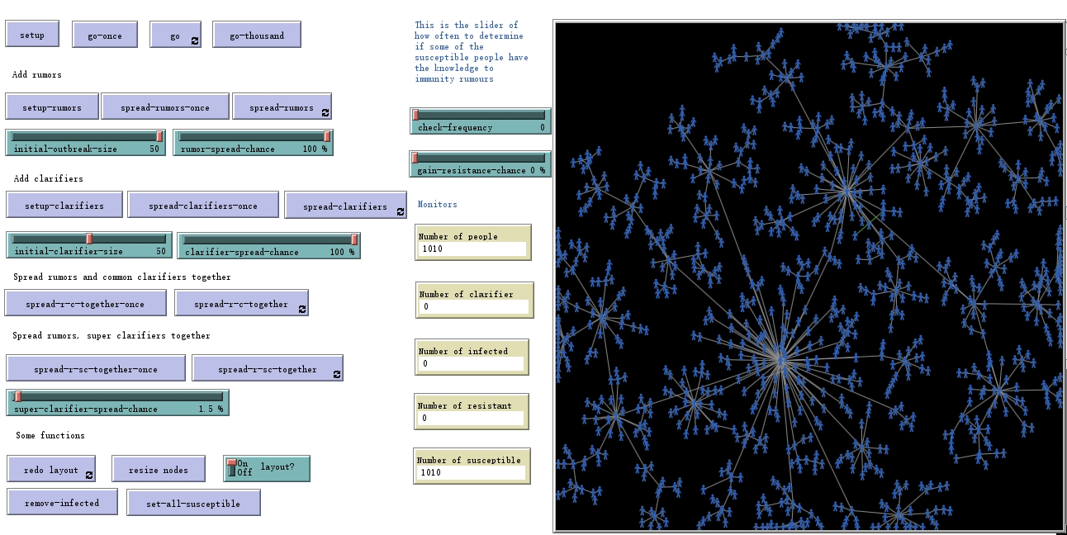
Modified Model (S-I-C)
Therefore, we change our strategy. We decide to spread clarifiers at first and then spread rumors after setting the same initial number of rumors and clarifiers.
As expected, the infected can not play a dominant role this time because most centers of clusters are clarifiers or near clarifiers.
Then we increase the number of clarifiers to maximum, the infected become fewer.

Slide 16

Modified Model (S-I-SC)
We set all the parameters of rumors to the maximum, the number of super clarifiers to “1” and super clarifier spread probability to only 5%. And we use the spread together button to run the program. At first, the rumors take the dominant position, as time goes by, super clarifiers are becoming more and more dominant. Finally, all the nodes become super clarifiers.

Slide 17
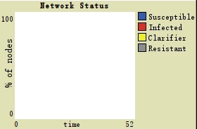
Calibration and Validation
Initial-outbreak-size: 50
Rumor-spread-chance: 100%
Initial-clarifier-size: 1
Super-clarifier-spread-chance: 5%
From the simulation we could see that our model fits the stylized fact.
The hysteresis of clarifying rumors
Even the super clarifier publish the truth as soon as they notice the rumor, the transformation from the infected to the super clarifier still need a period of time, which means the rumor may still cause damage.

Slide 18
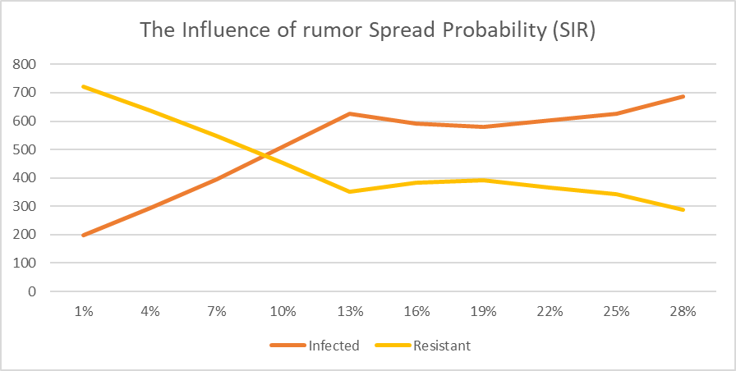
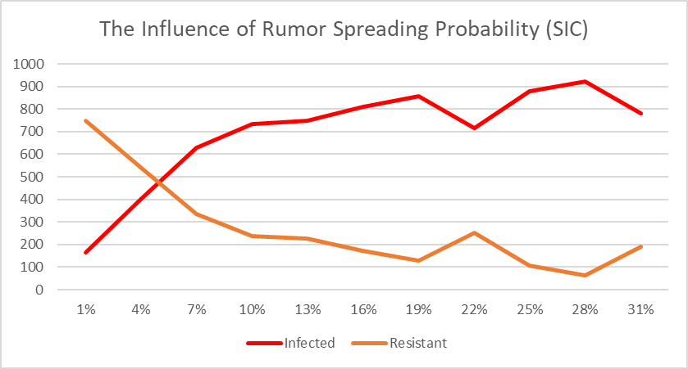
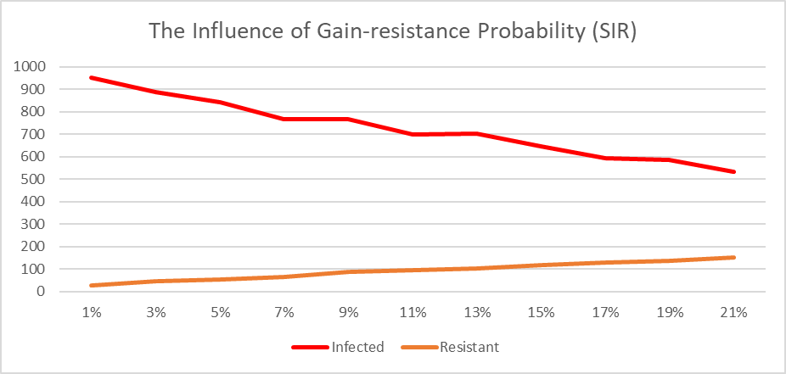
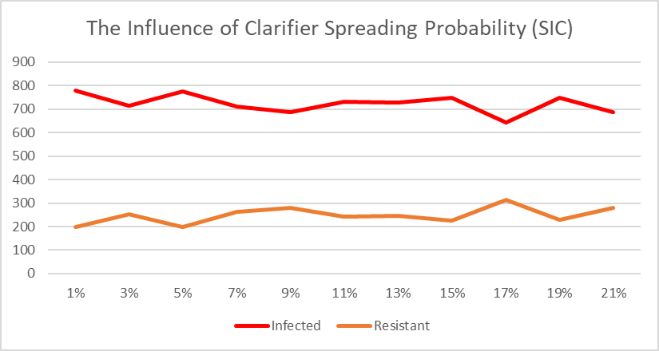
Sensitivity Analysis

Slide 19
Conclusion

Slide 20
Conclusion
After some experiments with the rumor spreading model, we find three main factors that may greatly affect rumor spreading:
1. Rumor spread probability. According to the sensitivity analysis, rumor spread probability is an essential factor.
2. Consciousness of resistance. We can see that the results are different between the experiment with resistant people and experiment without resistant people. Therefore, if more individuals can realize bad effects of rumors by themselves, the rumor will not spread fast any longer.
3. Influence of a clarifier. Both the center of a certain cluster and the power of a clarifier are manifestations of the influence. If a person is in the center of a small network, people around him/her will be influenced easily no matter what he/she says is good or bad. Moreover, if a person have a great power to influence others, what he/she says will also be spread fast no matter it is good or bad.

Slide 21
Suggestions
Social media platforms or public service organizations could make some videos to improve users' ability to distinguish rumors, especially those who have a lot of influence.
Social media platforms could set up a mechanism to filter the rumor content which user complain about automatically.
Organizations could cooperate with the social media sensation who has more influence to clarify the rumors.

Slide 22
Limitation and Future Work
We did not consider all the features of rumor spreading on the social media, we could try to add more parameters to the model, and then observe effect of these new parameters in the future.
In the analysis part, we only consider the influence of single factor. We could analyze the combination of multiple factors in the future.
To analyze the SIC model clearly, we did not considered the agent R influenced by C as well as the agent R transferred from S together, we could explore the situation with both of them in the future.

Slide 23
THANKS FOR WATCHING

